Slide 1
EN2130 – Communication Design Project
Course Project

Slide 2
Learning outcomes
Identify the requirements and limitations of a basic communication system.
Select a suitable communication technology to cater to a given simple application.
Select necessary components to build a simple communication system (wired/wireless) to solve a given problem.
Realize a simple communication system to enable successful end-to-end connectivity.

Slide 3
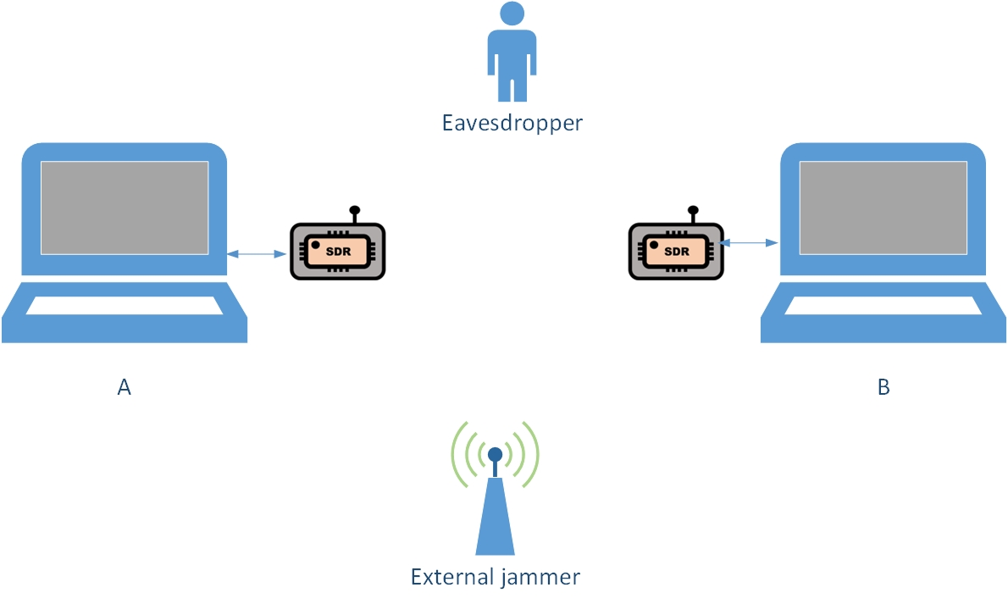
Requirements
Implement a point-to-point digital wireless communication system using software defined radios
Communications must be secure and reliable

Slide 4
Requirements
Transmitter design
Encoding
Security implementation
Reliability enhancement
Jamming protection
modulation
Receiver design
Reliability enhancement
Demodulation
decoding

Slide 5
Requirements
Communications to occur in the 2.4 GHz ISM band
Adhere to maximum power limitations
User interface
Performance evaluation
With distance
End-to end delay
Optional features
Channel estimation
Adaptive transmission
Closed-loop system

Slide 6
Evaluation
Presentation – 10 mins (50%)
Explaining the design methodology
Justification of selected techniques and parameters
Performance figures
Demonstration (30%)
Functionality check
Individual questioning (20%)
Understanding of the overall design

